Slide 1

Introduction to NHibernate
or that which will finally rid us of the evil DBAs

Slide 2
What is NHibernate
Open source software
Object relational mapper (ORM)
.NET port of Hibernate (Java ORM)
Awesome

Slide 3
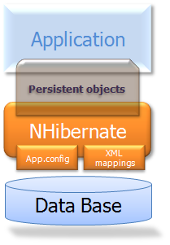
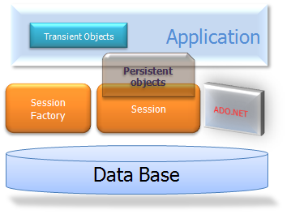
The Moving Parts

Slide 4
Concepts
Configuration – a set of directives that determine how NHibernate behaves
Session – mapped entities are retrieved from, and attached to, an active session
Session factory – uses a specified configuration to create sessions
Transaction – a grouped series of one or more actions (queries) performed against a session

Slide 5
Transient object – an object that has no persistence
Persistent object – an object that is mapped to a record in the data store, and is managed by the NHibernate session; NHibernate guarantees that persistent identity is equivalent to CLR identity (in-memory location of the object)
Detached object – a persistent object that is no longer associated with an active session (via serialization, closed session, etc.)

Slide 6
Getting NHibernate
SourceForge - http://sourceforge.net/projects/nhibernate/
NHForge - http://nhforge.org/media/

Slide 7
Referencing NH Assemblies
Required binaries
NHibernate.dll
Antlr3.Runtime.dll (used for parsing and interpreting HQL)
Iesi.Collections.dll (adds support for specialized collections)
Log4net.dll (logging support for NHibernate)

Slide 8
Optional Castle binaries for lazy loading
Castle.Core.dll
Castle.DynamicProxy2.dll
NHibernate.ByteCode.Castle.dll
Other lazy loading providers
LinFu
Spring

Slide 9
Configuring NHibernate
Create configuration file
Set configuration directives
Initialize session factory

Slide 10
Configuration Directive Location
App.config / Web.config file
Add NHibernate configSection
Add hibernate-configuration block
External configuration file
XML file with hibernate-configuration block
Reference nhibernate-configuration.xsd for XML intellisense
Must be copied to output directory when project is built

Slide 11
hibernate-configuration Directives
session-factory properties
connection.driver_class – specific connection driver class (e.g., NHibernate.Driver.SqlClientDriver)
connection.connection_string – database connection string OR connection.connection_string_name – if your connection string is defined in App/Web.config
dialect – specific SQL language implementation provider (e.g., NHibernate.Dialect.MsSql2005Dialect)
proxyfactory.factory_class – proxy class to use for lazy-loading (e.g., NHibernate.ByteCode.Castle.ProxyFactoryFactory, NHibernate.ByteCode.Castle)

Slide 12
current_session_context_class – class used to bind a session to a given context (e.g., “web” = HttpContext)
Other properties affecting caching, joins, ADO.NET configuration, query interpretation, etc.
session-factory mapping
assembly – location of NHibernate entity mapping files

Slide 13
Initializing the Session
ASP.NET/MVC Global.asax
Application_Start()
Create instance of ISessionFactory
Application_BeginRequest()
Open ISession instance
Bind session to ManagedWebSessionContext
Application_EndRequest()
Unbind session from ManagedWebSessionContext
Flush and close session

Slide 14
Application_End()
Close the session factory
In general
The session factory should live as long as the application does
An open session should live as long as a request is active
A transaction should live as long as a “unit of work” is being executed

Slide 15
Domain Model

Slide 16
Data Model

Slide 17
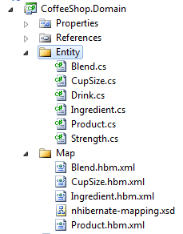
Mapping Entities

Slide 18
NHibernate Mapping Methods
Method | Source | Pros | Cons
XML HBM files | Native | Fairly easy to edit XSD schema provides intellisense Convention driven | It’s XML Automatic refactoring unavailable without third-party tools like ReSharper
FluentNHibernate | External DLL | Intuitive interface for simple mappings Refactoring support out of the box | Does not support all mapping features Complex mappings can be difficult to read

Slide 19
Mapping Basics
Class definition
Mapping is domain-centric, not data-centric
Special ID column and ID generator
Property definitions (convention-driven)
Scalar properties
Entity properties
Relationship
Collection property definitions
Relationship
Key column

Slide 20
Subclass definitions
Mapping files
[EntityName].hbm.xml
Must be embedded resources in containing assembly
Mapping assembly defined in config file, or individual mapped files may be added during session factory configuration
Intellisense provided by XSD

Slide 21
NHibernate Query Methods
Method | Source | Pros | Cons
HQL (Hibernate Query Language) | Native | Easy to construct complex queries | String-based, not strong typed
Criteria API | Native | Strong typed Incredibly robust | Learning curve can be difficult at first
NHibernate.Linq | External DLL | Strong typed Intuitive | Lacks some features of Criteria API External assembly unsigned, and sources not available (!)

Slide 22
Criteria API Basics
ICriteria
A base entity “query” interface to which “criterion” expressions may be attached
Usage: ISession.CreateCriteria<TEntity>()
May be nested if criterion expressions or projections need to be added to other entities in the entity object’s graph
ICriterion (where, and, equals, in, etc.)
A condition added to a criteria to produce a result

Slide 23
NHibernate.Criterion.Restrictions provides access to common criterions
Usage: ICriteria.Add(Restrictions.Eq(…))
IProjection (row count, distinct, min, max, etc.)
Used to perform aggregate operations on a criteria query
NHibernate.Criterion.Projections provides access to common projections
Usage: ICriteria.SetProjection(Projections.Max(…))

Slide 24

CoffeeShopMVC

Slide 25
Resources
Reading
NHibernate documentation http://www.nhforge.org/doc/nh/en/index.html
Ayende Rahien’s blog http://ayende.com/blog/default.aspx
NHibernate in Action (book) http://manning.com/kuate/
Watching
Mastering NHibernate (TekPub) http://tekpub.com/production/nhibernate
Summer of NHibernate http://www.summerofnhibernate.com/

